Slide 1
PRIYADARSHINI COLLEGE OF ENGINEERING NAGPUR
CHEST X-RAY ANALYSIS USING DEEP LEARNING ALGORITHM
Name of the Students
Bhavesh Verulkar
Prathamesh Tonge
Sankalp Thakre
Shreya Balpande
Pranjali Parshive
Under the Guidance of
Mr.P.U.Tembhare
Assistant Professor
Department of Computer Technology

Slide 2
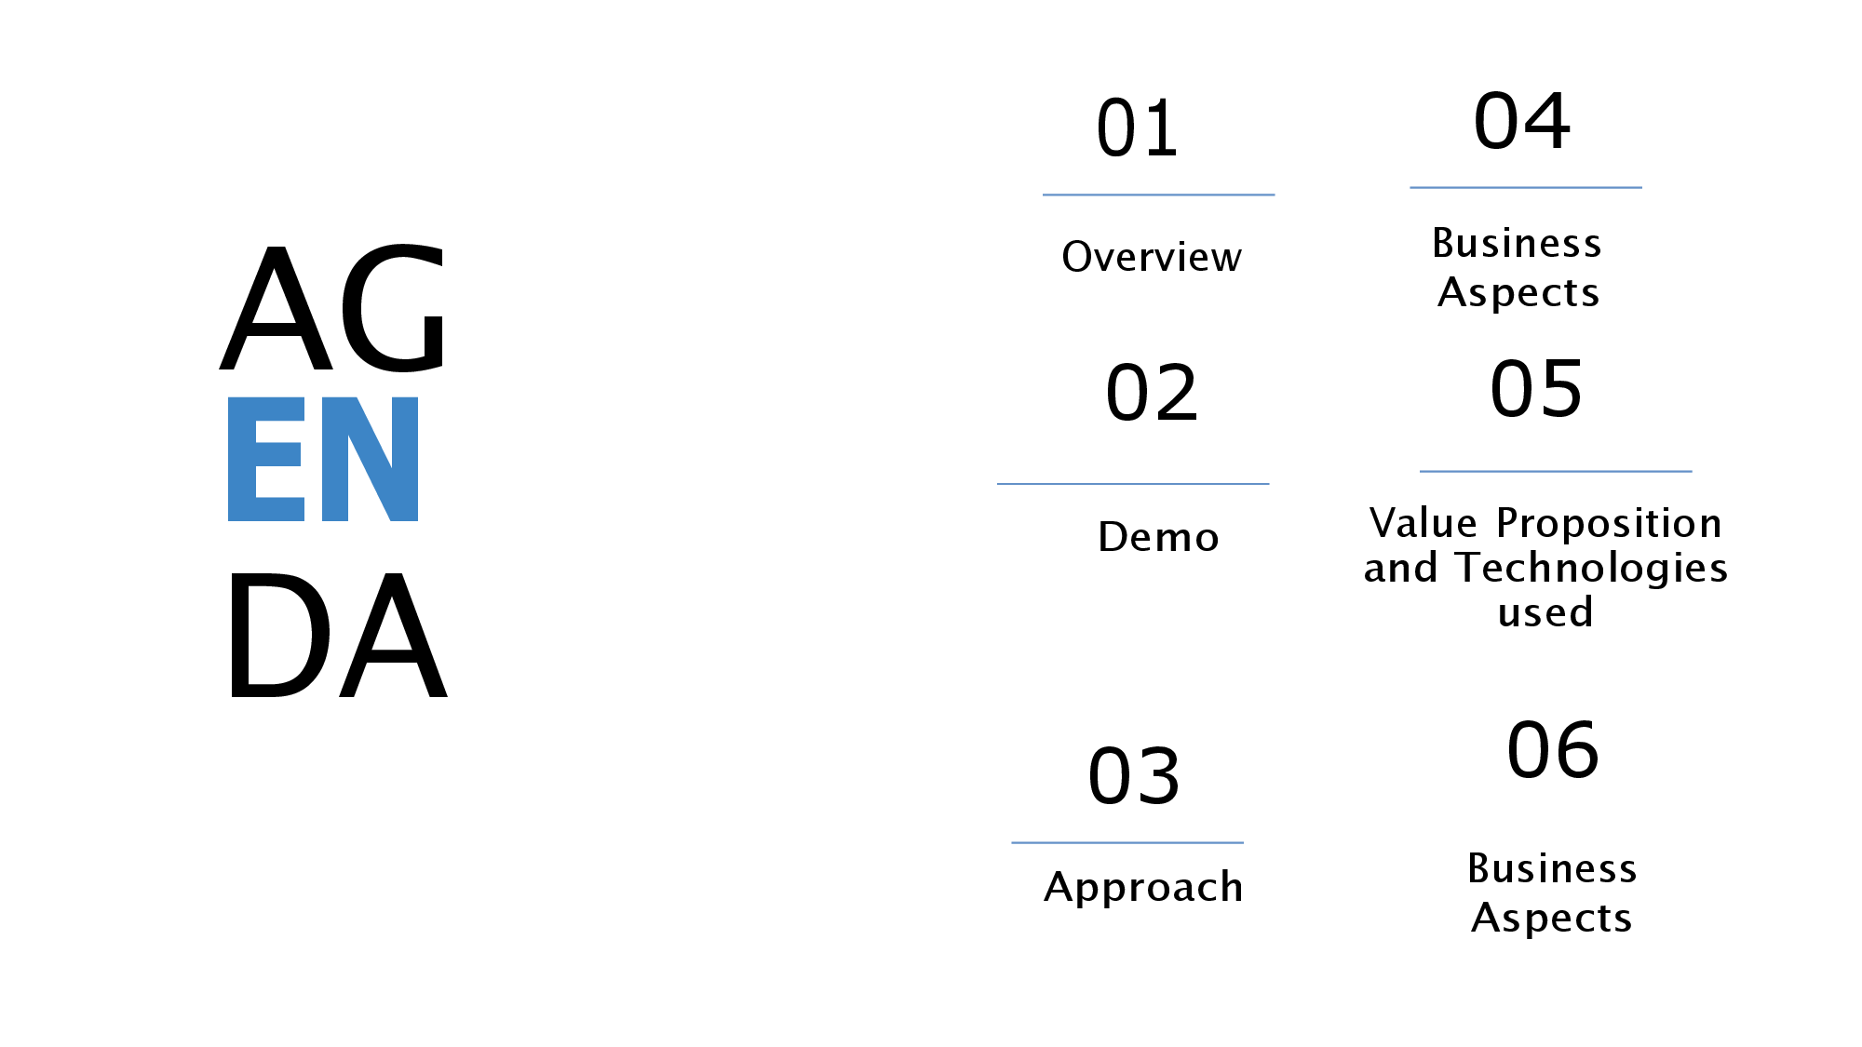

Slide 3
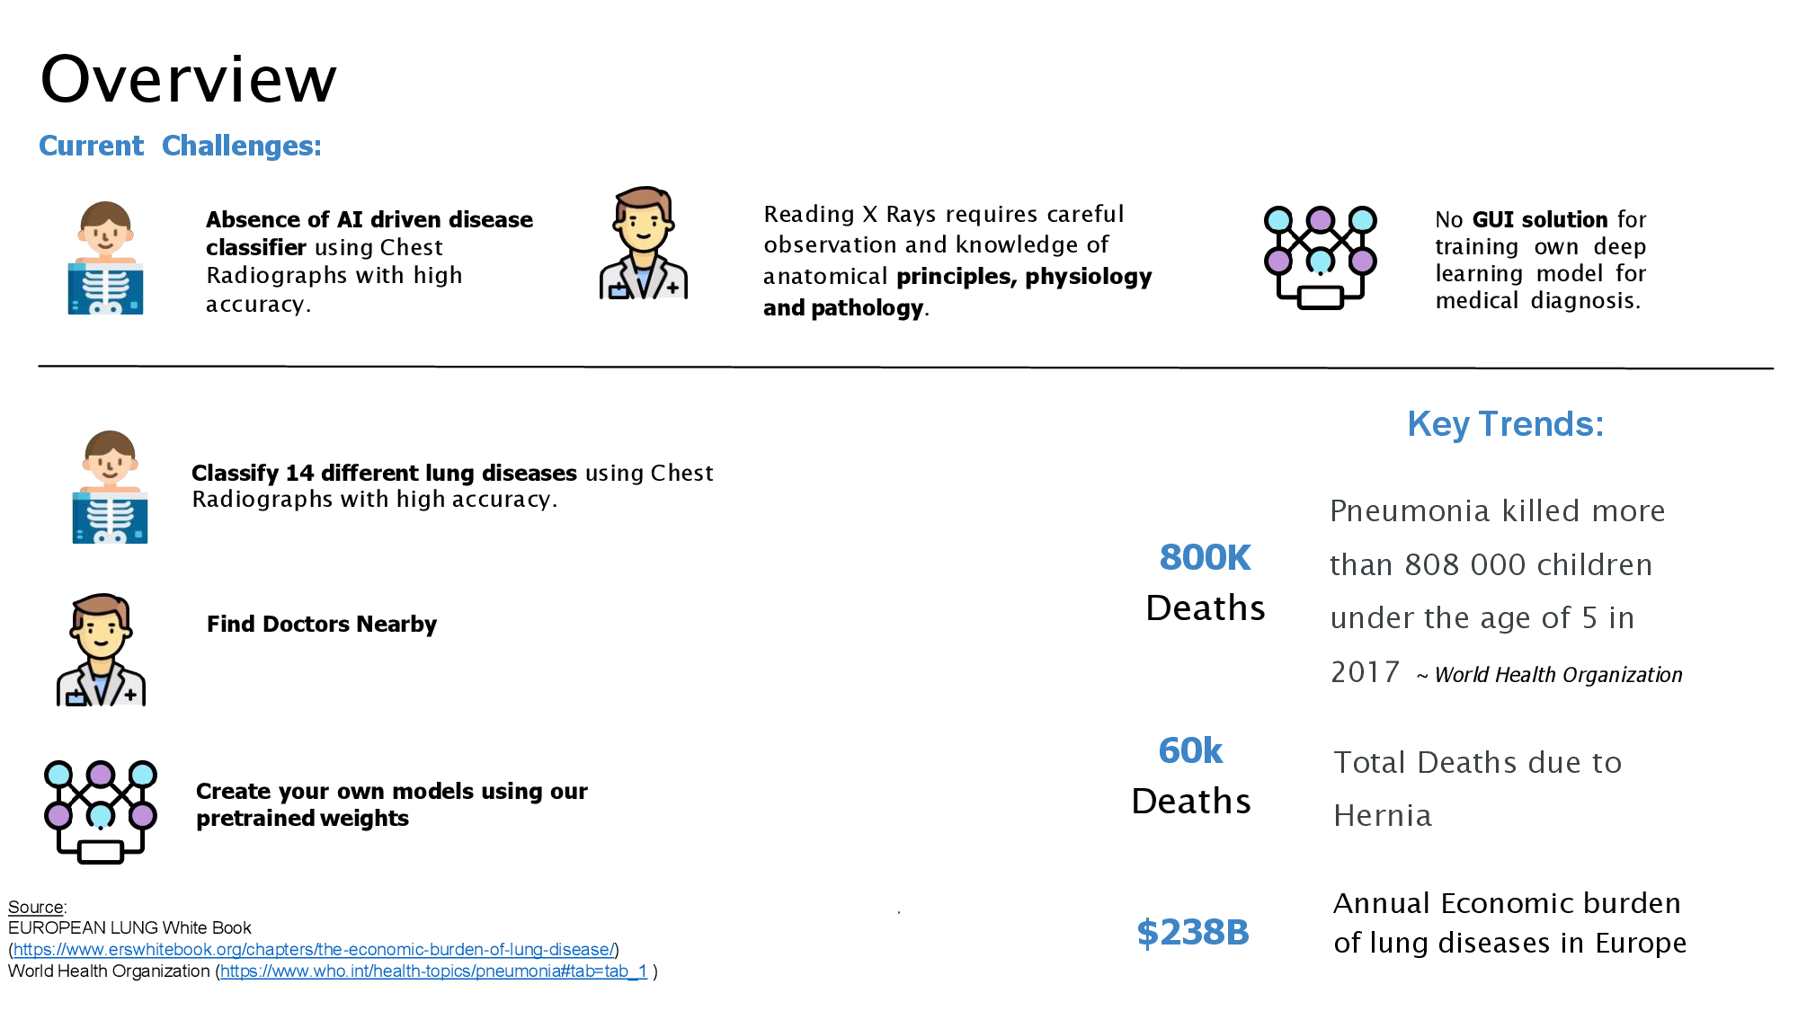

Slide 4
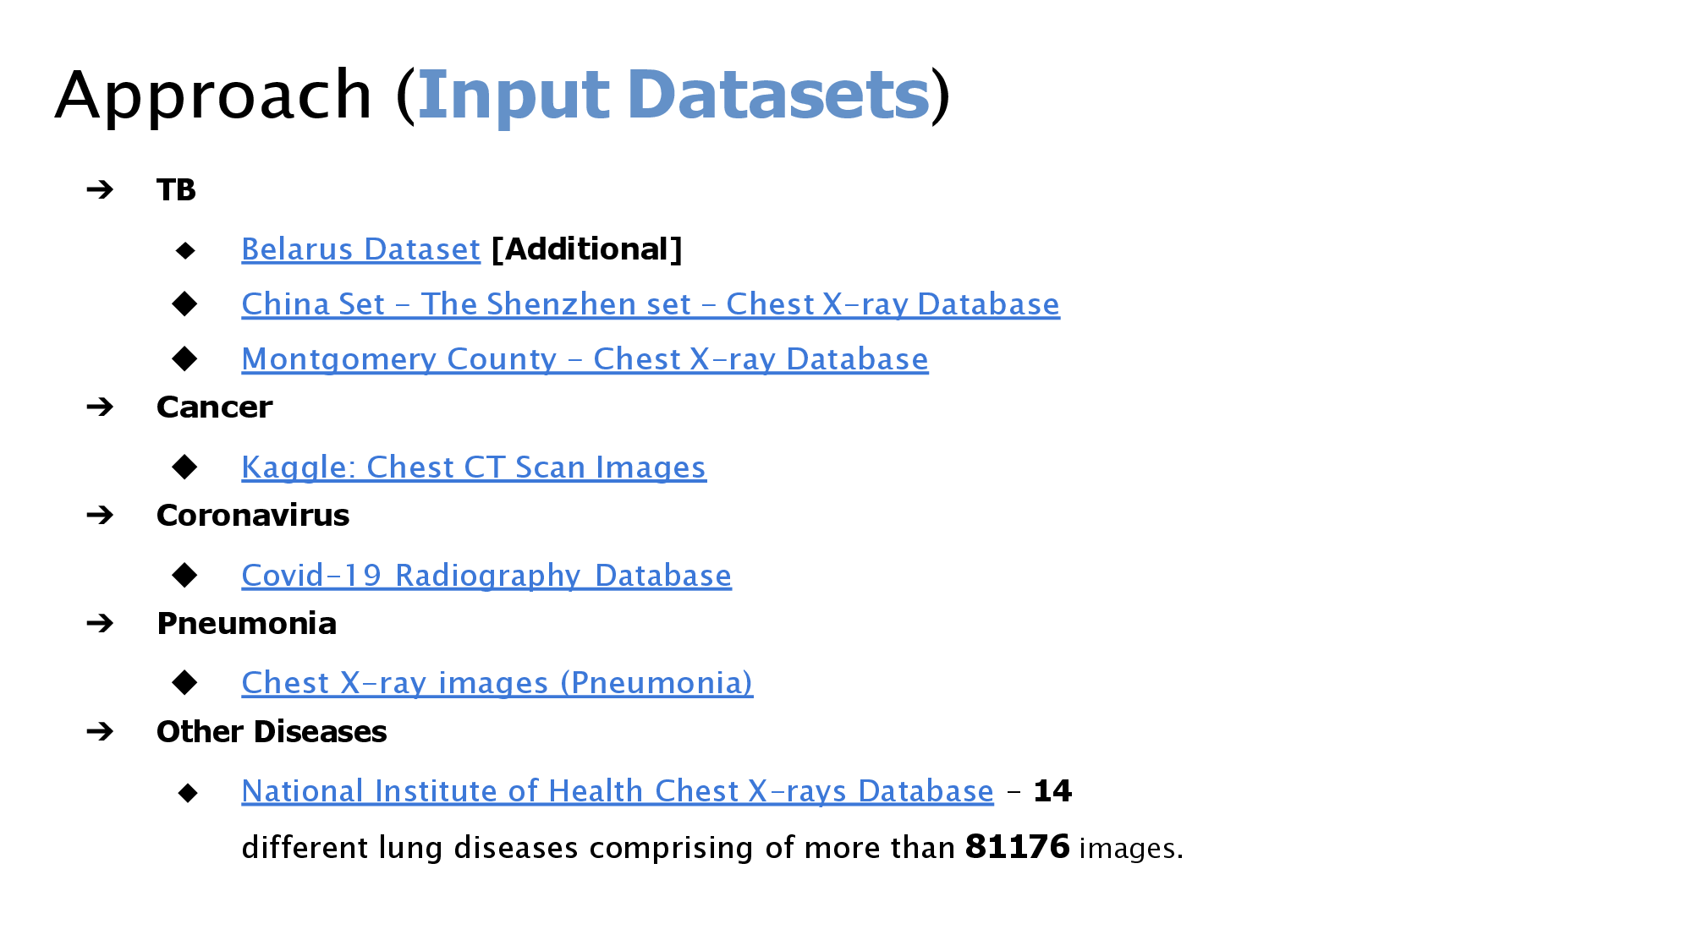

Slide 5
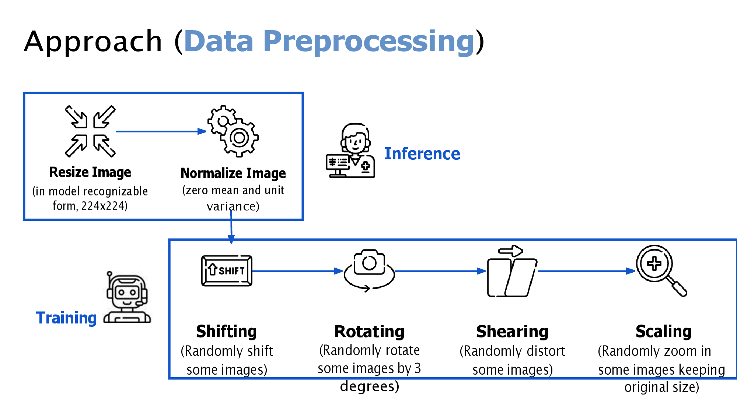

Slide 6
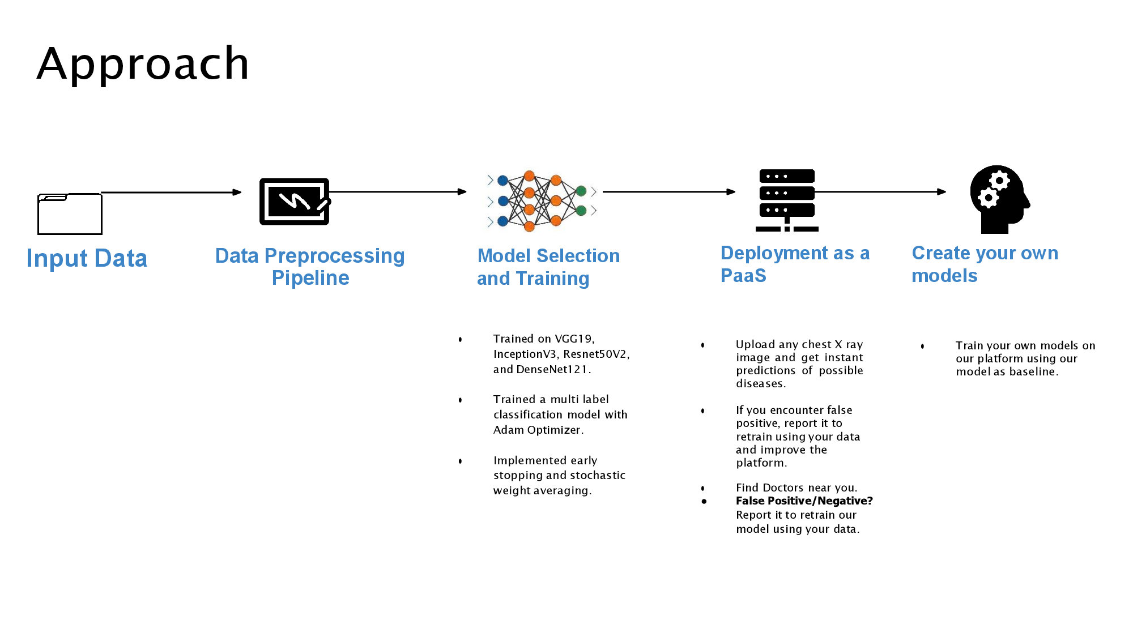

Slide 7
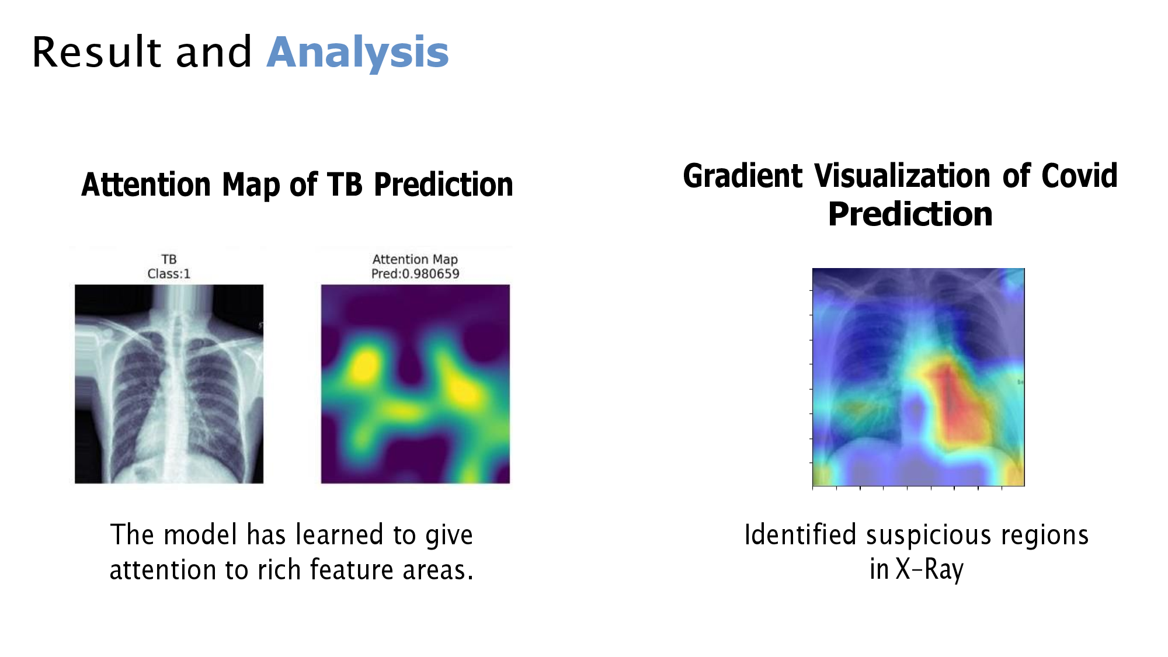

Slide 8
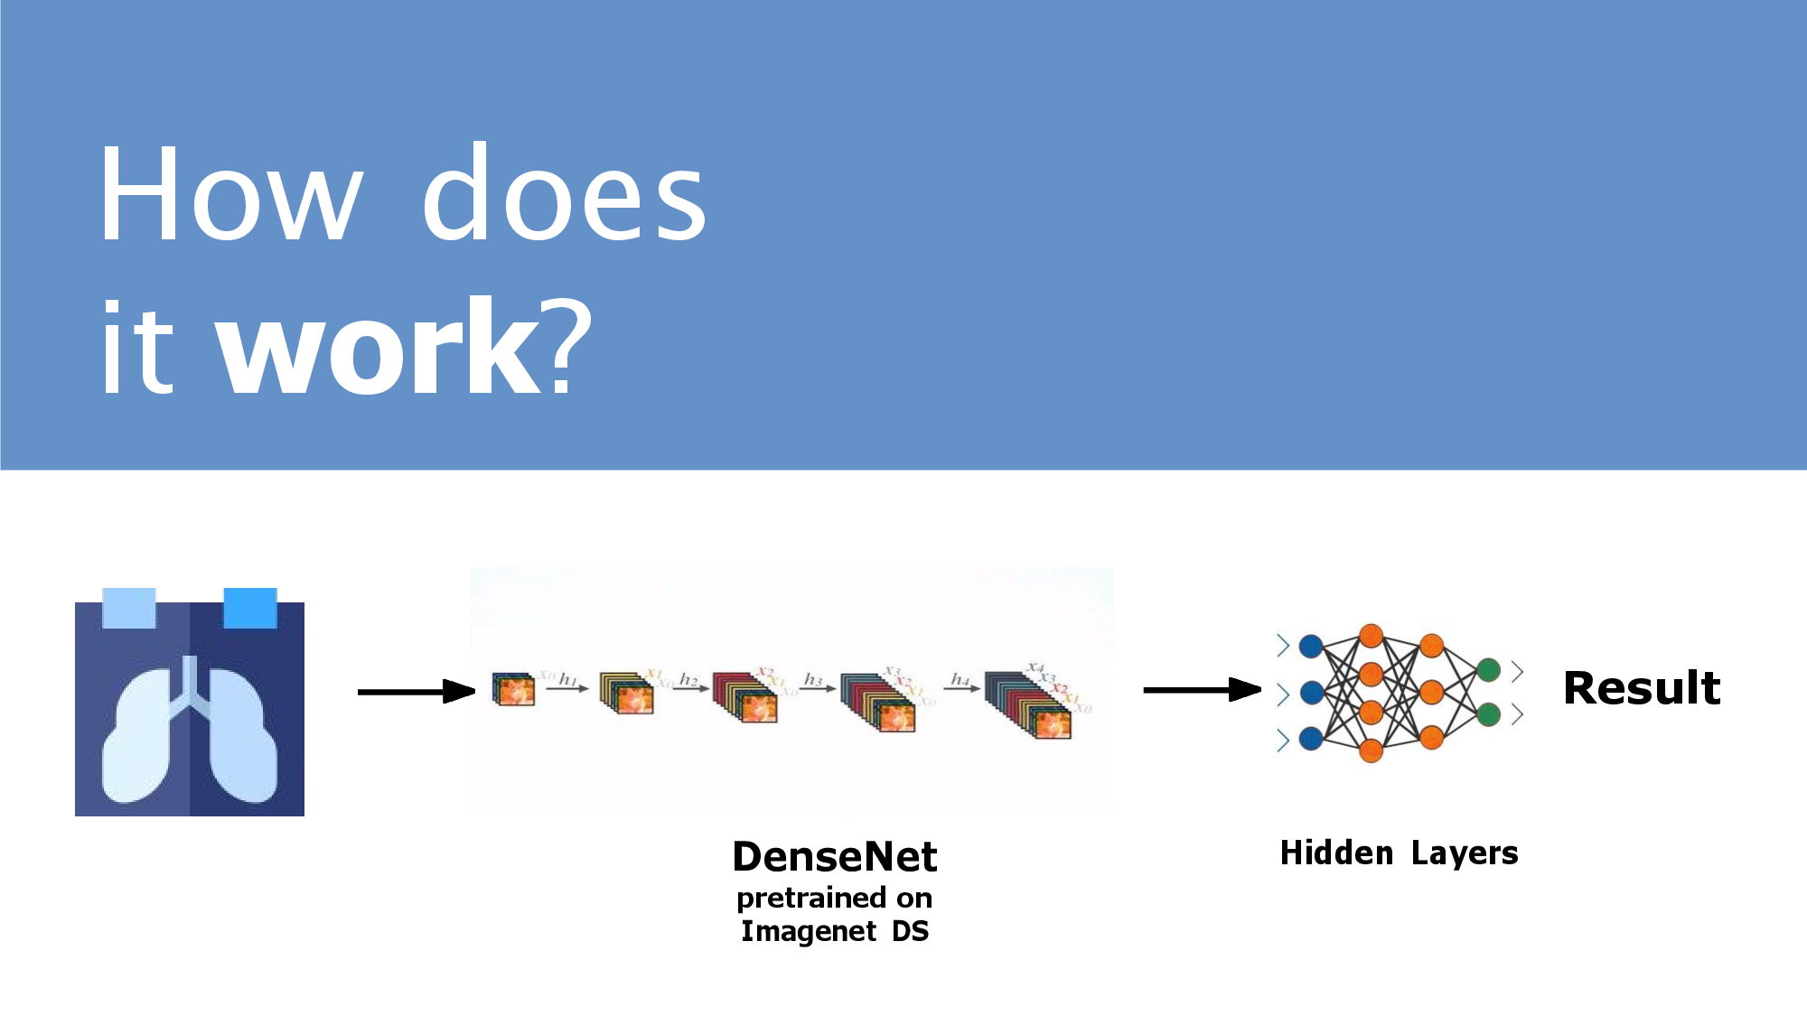

Slide 9
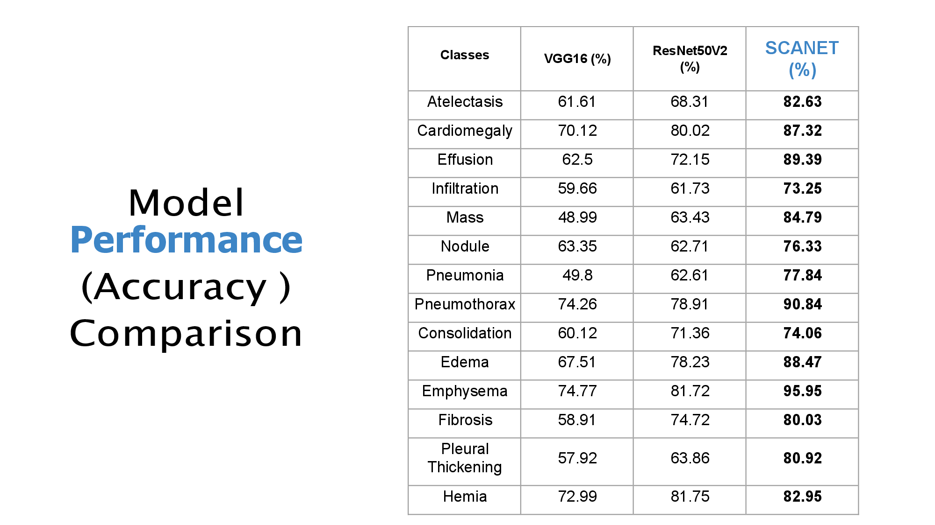

Slide 10
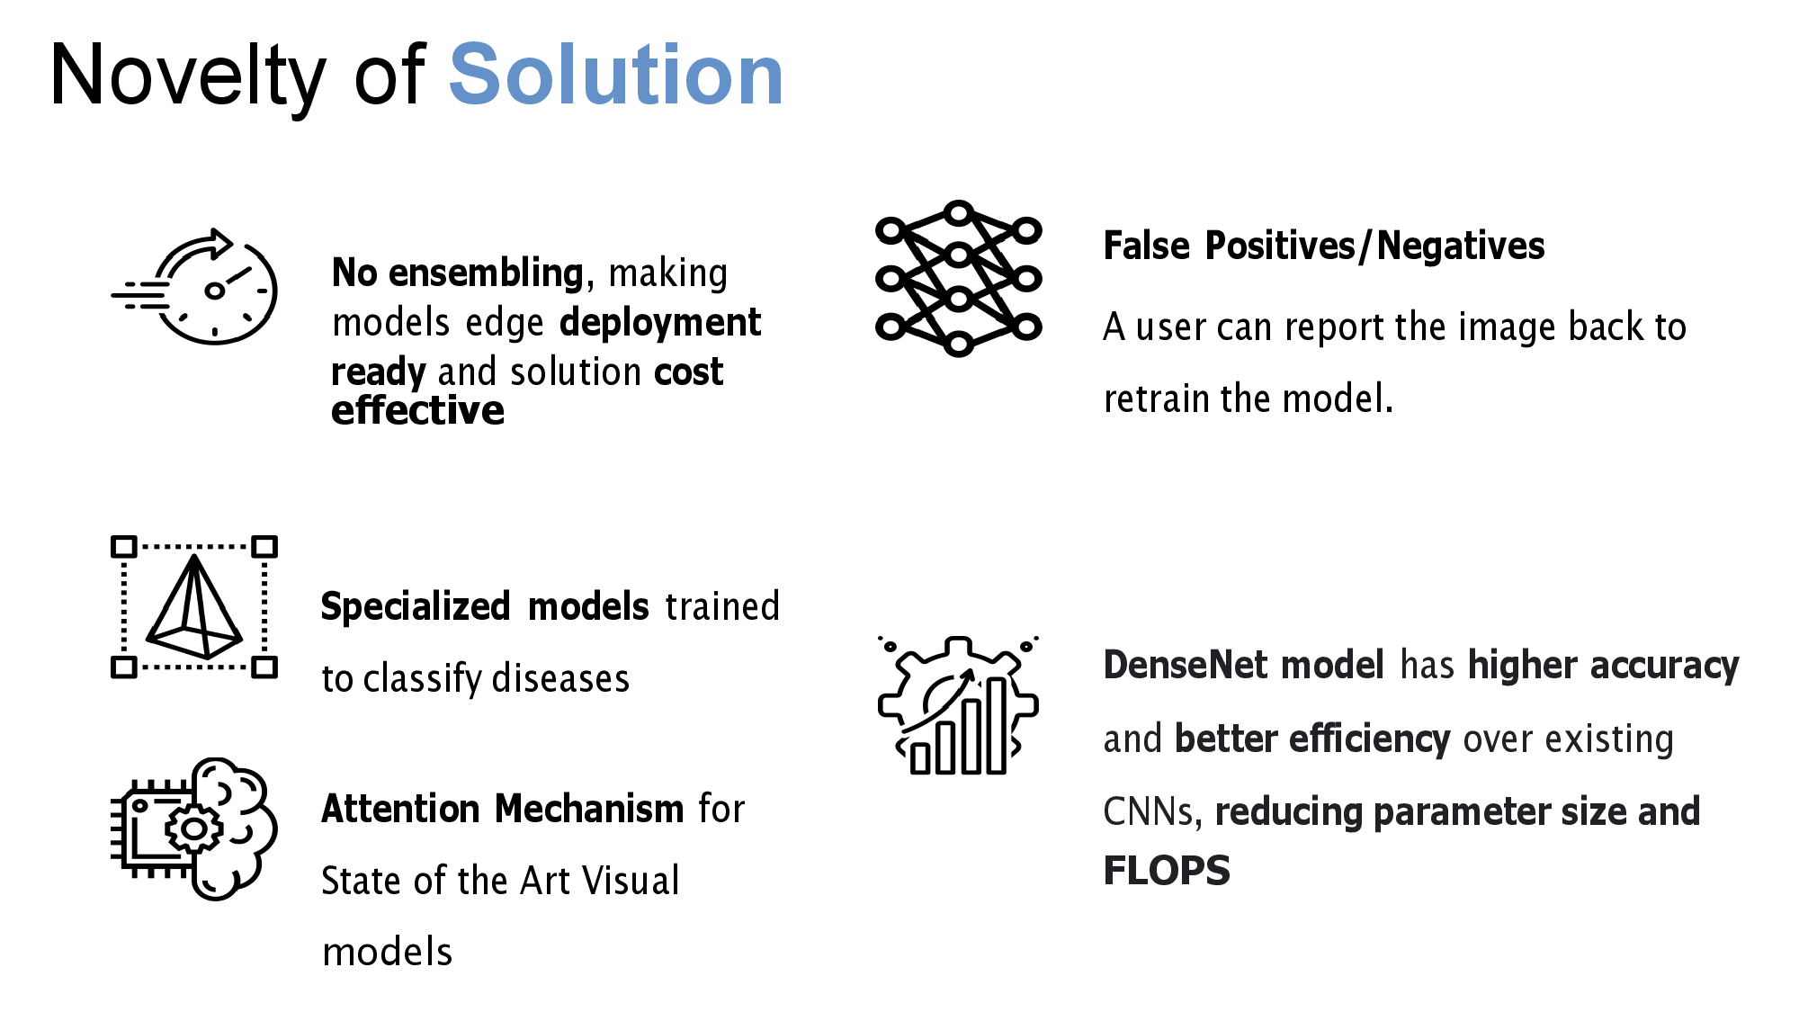

Slide 11
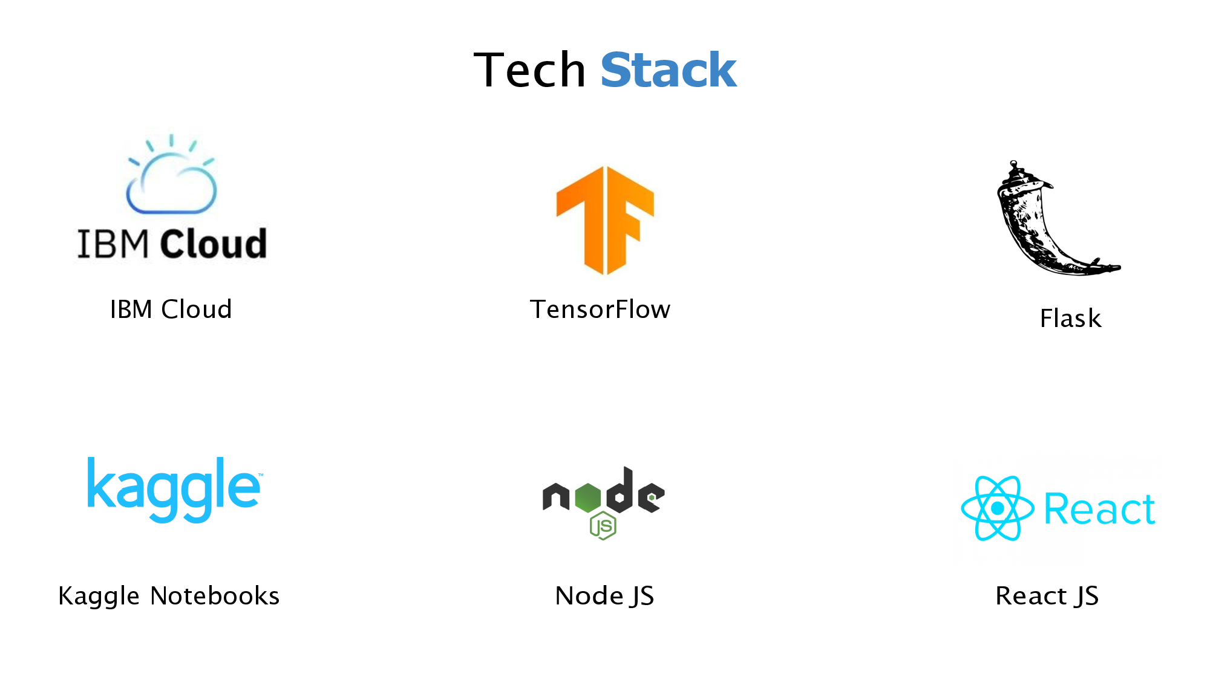

Slide 12
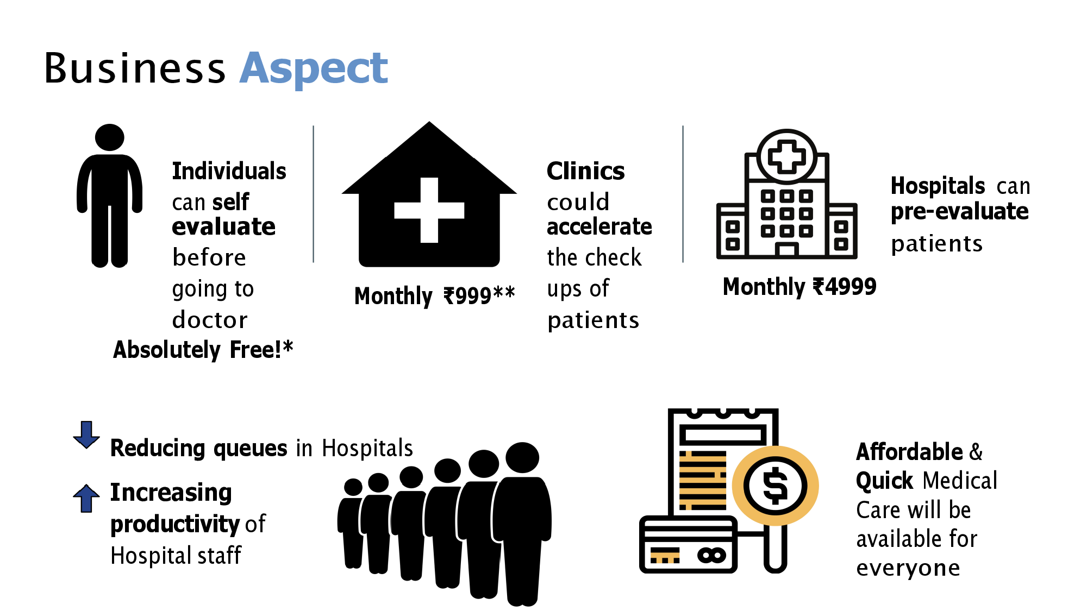

Slide 13
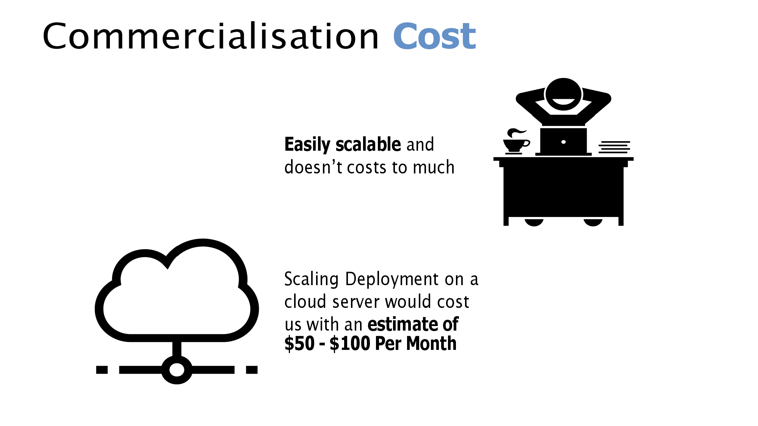

Slide 14
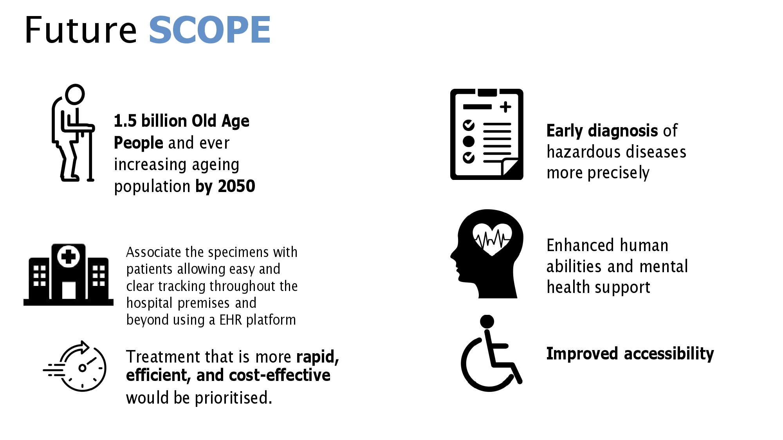

Slide 15
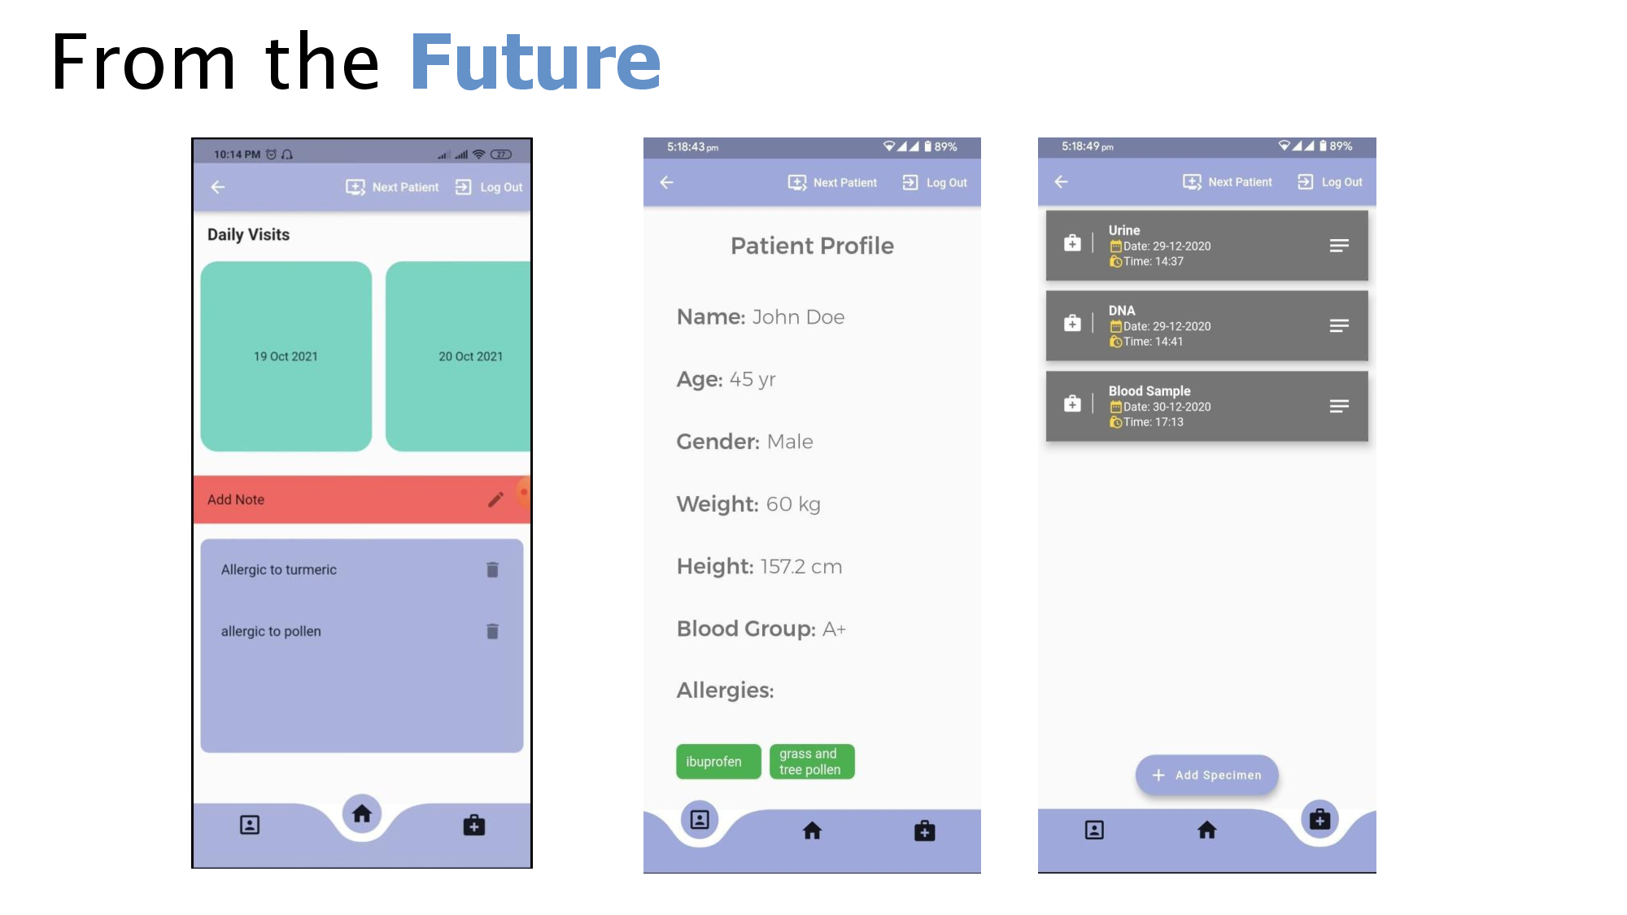

Slide 16
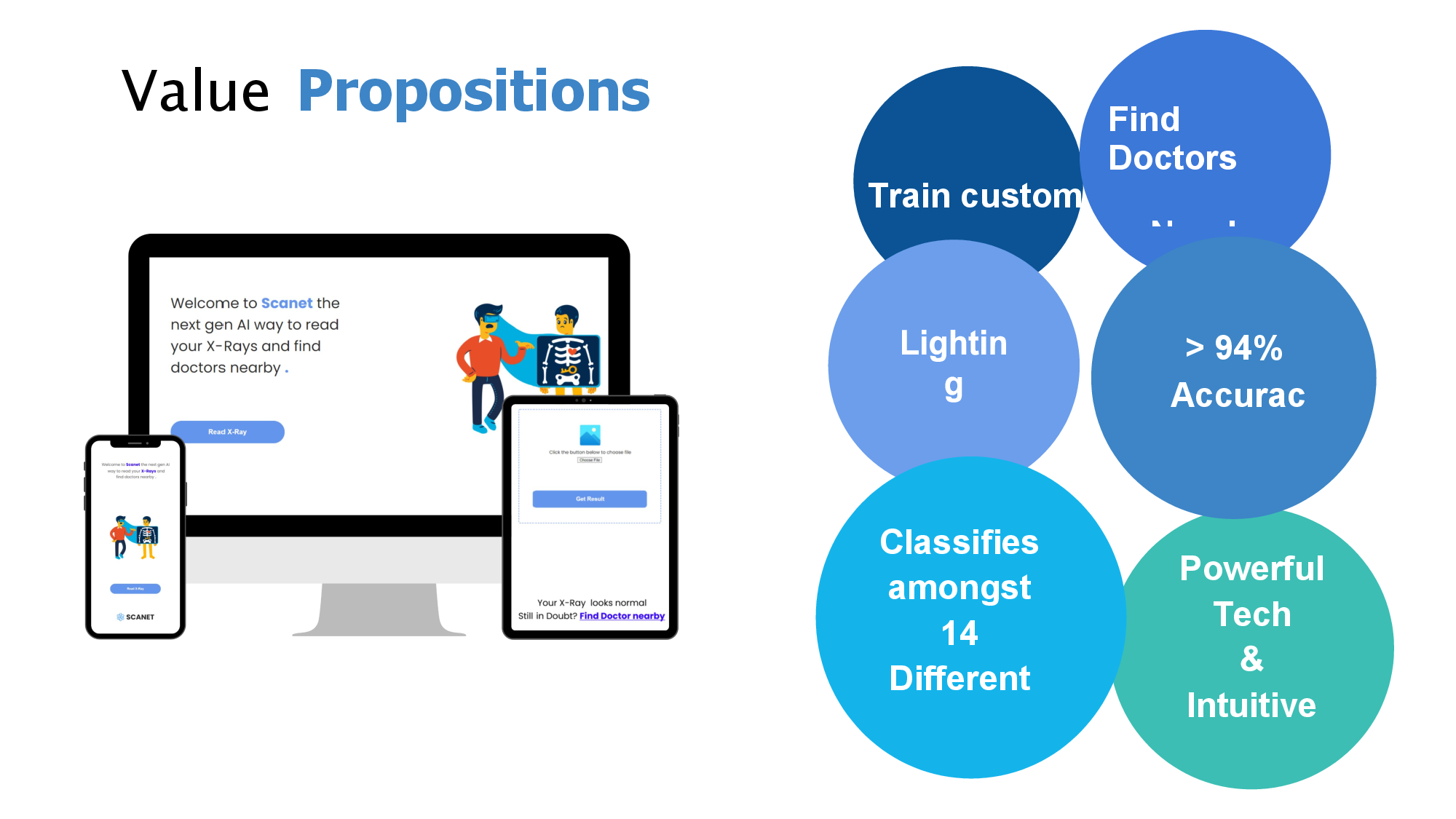

Slide 17


